Slide 1


FUNDAMENTALS OF DATA ANALYTICS MOBILE PRICE DATA ANALYSIS
PREPARED BY GROUP - 4
SALMAN KHAN
GOWRI ROHITH CHIRRA
RATNESH CHILAMKURTHI
BHANUPRASAD UNNAM
MANIKANTA MODUGULA
RISHI VARDHAN REDDY NAVARU
PROFESSOR: ANKUR ARORA

Slide 2

CONTENTS
INTRODUCTION
SCOPE
DATASET DESCRIPTION
SUMMARY STATISTICS
DATA SUMMARIZATION
DATA CLEANSING
OUTLIER ANALYSIS FOR BATTERY POWER
OUTLIER ANALYSIS FOR RAM
OUTLIER ANALYSIS FOR INTERNAL MEMORY
HYPOTHESIS TESTING
LINEAR REGRESSION
CHALLENGES
CONCLUSION

Slide 3
INTRODUCTION
Mobile phones have become an integral part of modern life, connecting people, facilitating communication, and providing a wide range of applications and services.
As the usage of mobile phones continues to grow globally, vast amounts of data are generated daily, capturing various aspects of users' interactions with their devices.
Mobile phone dataset analysis involves extracting meaningful insights and patterns from this rich pool of data to inform decision-making, enhance user experiences, and contribute to the improvement of mobile technologies.

Slide 4
SCOPE
User Behavior Analysis:
Examining how users interact with their mobile phones, including app usage patterns, frequency of calls and messages, and time spent on different activities.
Identifying popular applications and understanding user preferences.
Device Performance:
Assessing the performance of different mobile phone models under various conditions.
Analyzing device-specific data can help manufacturers improve hardware and software components.
Market Research:
Understanding market trends, consumer preferences, and competitive landscapes through the analysis of mobile phone sales, customer reviews, and data visualizations.
Predictive Analytics:
Using historical data to predict future trends, such as the adoption of new technologies, emerging markets, or shifts in user behavior.

Slide 5
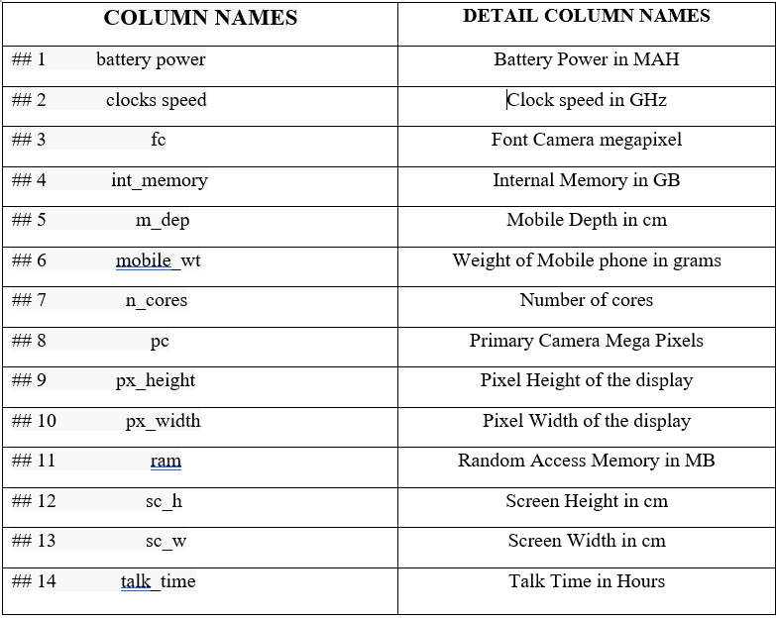
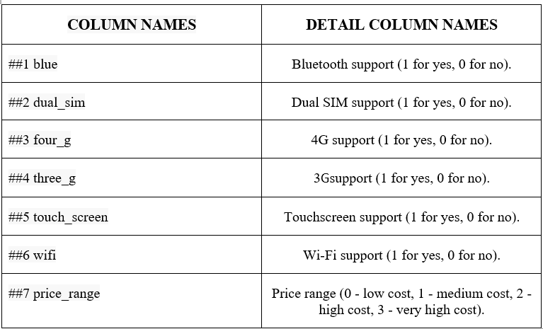
DATASET DESCRIPTION
For the data Analysis of our mobile prices dataset here we used R studio Programming Language for the statistical methods and to obtain values by processing into it.
According to the Data set given the data set consist of numerical data about mobile prices and there are some categorical data also inserted in the data set In the dataset we have 2000 observations of data and there are total 21 variables including numerical 14 and 7 categorical data

Slide 6
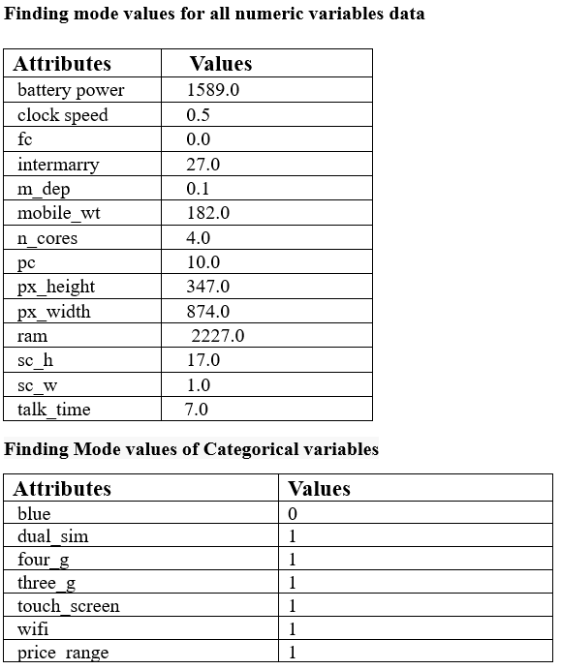
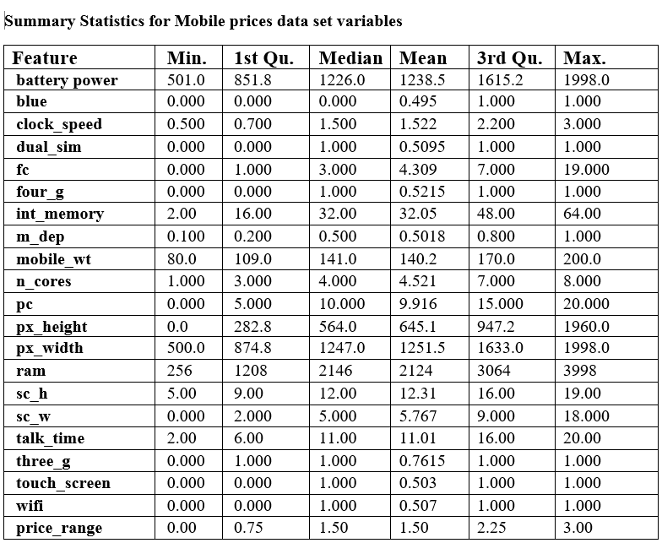
SUMMARY STATISTICS AND MODE DATA VALUES FOR MOBILE PRICES DATA SET VARIABLES

Slide 7
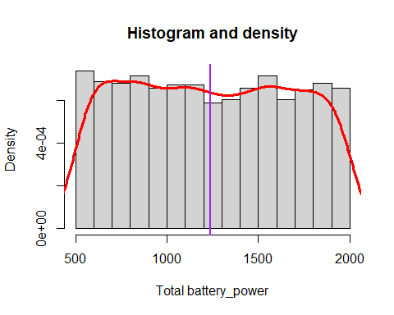
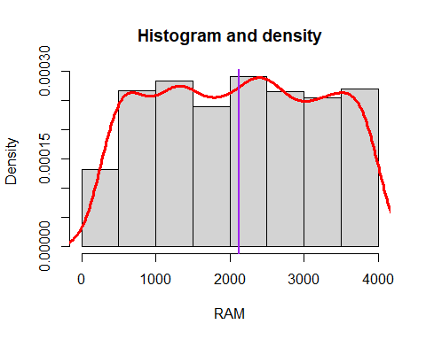
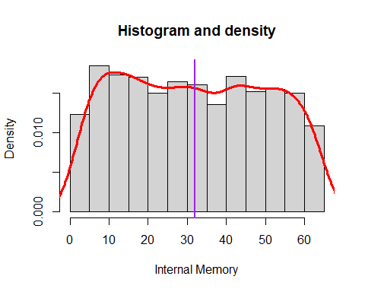
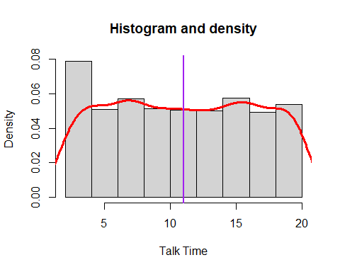
DATA SUMMARIZATION
Battery Power: The range of battery power is from 501 to 1998, with a mean value of 1238.5.
RAM: The RAM values range from 256 to 3998, with a mean value of 2124.
Internal Memory: The internal memory (int_memory) ranges from 2 to 64, with a mean of 32.05.
Front Camera (fc): The front camera ranges from 0 to 19, with a mean value of 4.309.
Price Range: The target variable, “price_range,” has values ranging from 0 to 3, indicating different price ranges or categories.
4G and Wi-Fi Support (four_g, wifi): These binary variables have means around 0.52, indicating that about half of the phones support 4G and Wi-Fi.

Slide 8

DATA CLEANSING
In the data cleaning and preprocessing phase, we addressed the following:
Checked for missing values (none found in this dataset).
According to the data we got we can tell there in no missing values “0” that to by considering the data from R Studio Programming language.

Slide 9
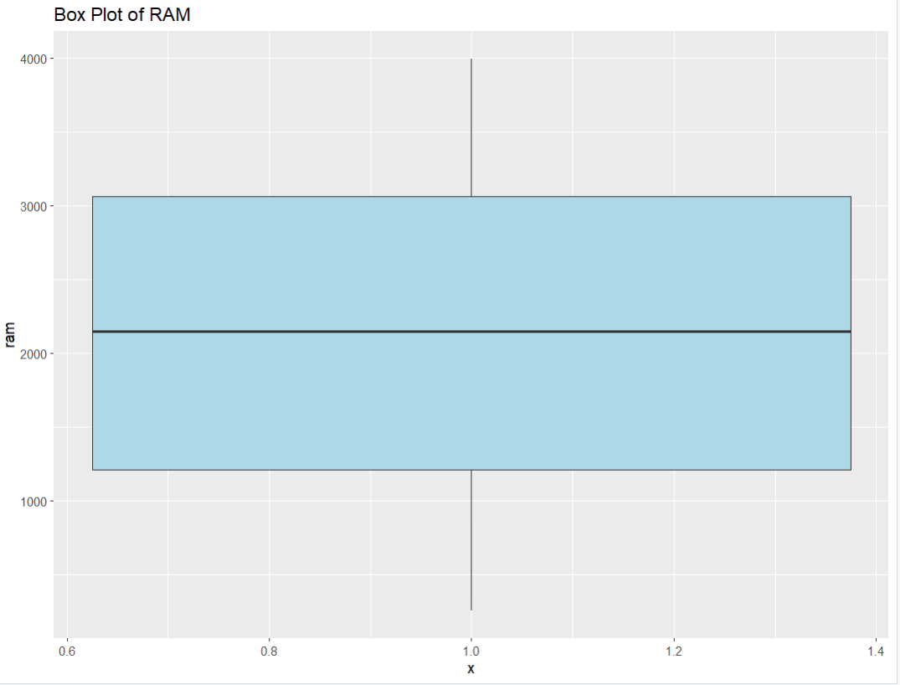
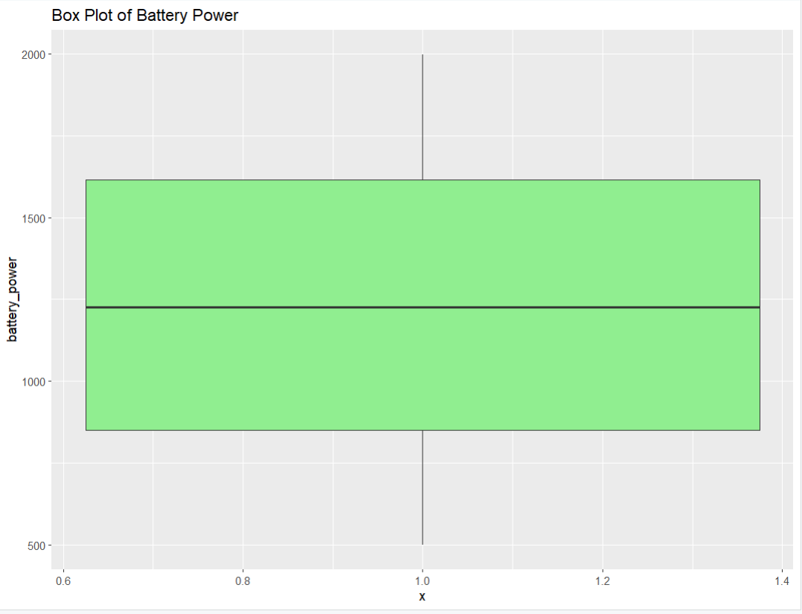
OUTLIER ANALYSIS FOR BATTERY POWER & RAM
The figure describes the outliers for the column ‘battery_power’
There are no outliers in the 'battery_power' variable.
All data points fell within the acceptable range, and no values were identified as outliers
The figure describes the outliers for the column ‘ram’.
There are no outliers in the ' ram'.
All data points fell within the acceptable range, and no values were identified as outliers

Slide 10
HYPOTHESIS TESTING
 | Battery Power Comparison
Objective | Test whether there is a significant difference in the mean battery power mobile phones or not compared to the 1200mah battery mean capacity.
Significance Level (α) | α = 0.05 (5%)
Test Statistic (Z-statistic) | 3.920183
P-value | 8.848183e-05
Decision | Since the p-value ( 8.84813e-05) is lesser than the significance level (α = 0.05), reject the null hypothesis.
Objective: To test whether the mean battery power of mobile phones in the dataset is equal to 1200 mAh.
1. Null Hypothesis (H0):
H0: The mean battery power is equal to 1200 mAh.
The null hypothesis represents the assumption that the mean battery power of mobile phones in the dataset is 1200 mAh.
2. Alternative Hypothesis (Ha):
Ha: The mean battery power is not equal to 1200 mAh.
The alternative hypothesis is a two-tailed statement indicating that the mean battery power differs from 1200 mAh in either direction.

Slide 11
3. Z test
The p-value obtained from the test was approximately 8.848183e-05, which is significantly smaller than the chosen significance level (α = 0.05). This low p-value led me to reject the null hypothesis.
The test statistic (Z-score) was approximately 3.920183, indicating a substantial difference from the assumed mean value.
4. Conclusion
Based on the analysis, there is sufficient evidence to conclude that the mean battery power of mobile phones in the dataset is not equal to 1200 mAh.

Slide 12
T-test
 | RAM Comparison
Objective | Test whether there is a significant difference in the mean RAM between mobile phones with 4G support and those without 4G support.
Significance Level (α) | α = 0.05 (5%)
Test Statistic (t-statistic) | 0.32713
P-value | 0.7436
Decision | Since the p-value (0.7436) is greater than the significance level (α = 0.05), we fail to reject the null hypothesis.
We performed a hypothesis test to investigate whether phones with 4G support have a significantly different average RAM compared to phones without 4G support.
Objective: To test whether there is a significant difference in the mean RAM between mobile phones with 4G support and those without 4G support.
1. Null Hypothesis (H0):
H0: The mean RAM of mobile phones with 4G support is equal to the mean RAM of mobile phones without 4G support.
The null hypothesis assumes no difference in the mean RAM between the two groups.
2. Alternative Hypothesis (Ha):
Ha: The mean RAM of mobile phones with 4G support is not equal to the mean RAM of mobile phones without 4G support.
The alternative hypothesis is two-tailed, indicating that there is a difference in mean RAM between the two groups.

Slide 13
3. Test Statistic (t-statistic):
In the results of the unpaired t-test, we are comparing the 'ram' values between two groups: phones with 4G connectivity (`with_4g`) and phones without 4G connectivity (`without_4g`).
The calculated t-statistic is approximately 0.32713.
4. Decision:
Since the p-value (0.7436) is greater than the significance level (α = 0.05), we fail to reject the null hypothesis.
This decision suggests that there is no strong evidence to conclude that the mean RAM of mobile phones with 4G support is different from those without 4G support.
5. Conclusion
Based on the analysis, we do not have sufficient evidence to claim a significant difference in the mean RAM between mobile phones with and without 4G support.
This result may be of interest to mobile phone manufacturers and consumers, as it indicates that the presence of 4G support does not significantly impact the mean RAM of mobile phones.

Slide 14
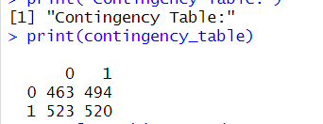
CHI-SQUARED TEST
We conducted a chi-squared test to examine the association between two categorical variables, namely 'four_g' and 'wifi,' in the dataset.
The table, displayed in Figure illustrates the counts of observations falling into each combination of categories:
After constructing the contingency table, we proceeded to perform the chi-squared test.
The test yielded a test statistic (X-squared) of 0.55238 with 1 degree of freedom.

Slide 15
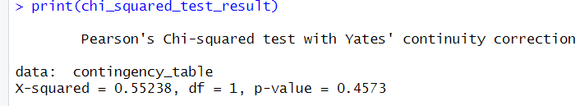
Additionally, I obtained a p-value of 0.4573. The results of the test were displayed in Figure.
Upon interpretation, the p-value of 0.4573 exceeds the commonly used significance level of 0.05.
Consequently, we fail to reject the null hypothesis. This implies that, based on the chi-squared test, there is insufficient evidence to suggest a significant association between the 'four_g' and 'wifi' variables.
The findings indicate that any observed differences in the distribution of categories between these variables may be attributed to random chance rather than a meaningful relationship.

Slide 16
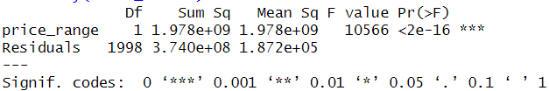
ONE WAY ANOVA
In this analysis, the variable is “Ram,” and the variable is “price_range,” which represents different price categories for mobile devices. The ANOVA table summarizes the sources of variability in the data and helps determine whether the means of the groups are significantly different.
Objective: To analyze that mean RAM values has any significant difference across different price ranges.
According to the p-value that we got obtained 2e-16 which is significantly lower than 0.05 threshold value.
1. ANOVA Table:
 | price_range | Residuals
Sum of Squares | 1978061205 | 374049364
Deg. of Freedom | 1 | 1998

Slide 17
2. Sum of Squares:
The sum of squares represents the total variability in the dependent variable “ram” that is partitioned into two components: variability
between the groups (price ranges) and variability within the groups (residuals).
Sum of Squares for “price_range” is 1,978,061,205, and for “Residuals” is 374,049,364.
3. Degrees of Freedom:
Degrees of Freedom (DF) represent the number of values in the final calculation of a statistic that are free to vary. For “price_range,” DF is 1, and for “Residuals,” it is 1998.
4. Residual Standard Error:
The residual standard error is a measure of the variability of the observed response values around the mean. In this case, it is approximately 432.6799.
5. Interpretation:
The small p-value (2e-16) associated with the “price_range” term in the ANOVA table indicates that there is a statistically significant difference in the means of “ram” across different price ranges.
The residual standard error provides an estimate of the variability of individual data points around the fitted regression line.
The results of the one-way ANOVA suggest that there is a statistically significant difference in the mean “ram” values across different price ranges.

Slide 18
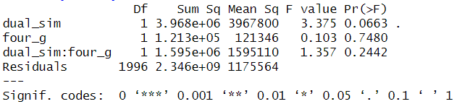
TWO WAY ANOVA
Call: The two-way ANOVA was conducted using the formula `ram ~ dual_sim * four_g` on the dataset.
Objective : to determine that if Dual sim and four_g affect the Ram specifications
Sum of Squares:
For “dual_sim” is 3,967,800.
For “four_g” is 121,346.
For “dual_sim:four_g” interaction is 1,595,110.
For residuals is 2,346,426,313.
Degrees of Freedom (DF):
For “dual_sim” is 1.
For “four_g” is 1.
For “dual_sim:four_g” interaction is 1.
For residuals is 1996.
Here we got P-value for dual sim 0.0663 for the dual sim and for the four_g the p value is 0.7480 and based on the both combined P- value is 0.2442 and the significance level is 5% = 0.05

Slide 19
4. Based on the P value that we got combined effect of dual sim and four_g got 0.2442 which higher compared to p-value both are significantly higher than 0.05.
Where if we take individually of dual sim and four g p values which both of them significantly higher than the 0.05.
5. Residual Standard Error: The standard deviation of the residuals is 1084.234.
The significant Sum of Squares for “dual_sim,” “four_g,” and their interaction, along with the large Residual Standard Error, indicates that there are substantial effects of both “dual_sim” and “four_g” factors on the “ram” variable.
The interaction effect suggests that the combination of these factors may also influence the response variable.
The Degrees of Freedom help in understanding the flexibility of the model, and the note about estimated effects being unbalanced suggests a potential uneven distribution of data points among different levels of the factors.
Overall, the two-way ANOVA results provide insights into that there is a combined impact of “dual_sim” and “four_g” on RAM specifications.

Slide 20
LINEAR REGRESSION
A simple linear regression model was applied to explore the connection between the “battery_power” (dependent variable) and “talk_time” (independent variable) in a dataset containing various mobile device features.
The linear regression model generated for the data is expressed as:
Coefficients Interpretation:
Intercept (1192.020): The intercept represents the estimated battery power when the talk time is zero. However, in the context of this model, this value may not have a practical interpretation as talk time is unlikely to be zero for mobile devices.
talk_time (4.223): The coefficient for talk time indicates that, on average, for each additional unit increase in talk time, the battery power is estimated to increase by 4.223 units.
battery_power = 1192.020 + 4.223*talk_time

Slide 21
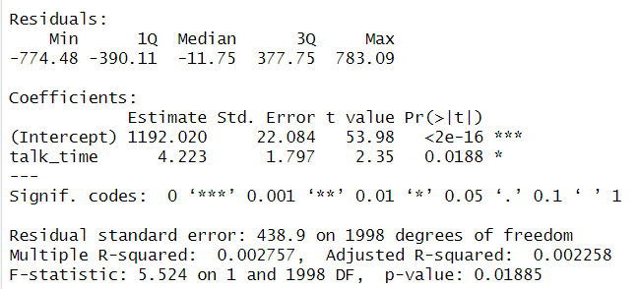
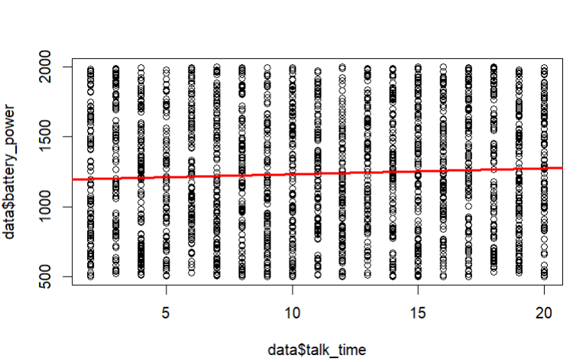
Statistical Significance:
The p-value associated with the coefficient for talk time is 0.0188, which is less than the conventional significance level of 0.05. This suggests that there is a statistically significant relationship between talk time and battery power.
Model Fit:
The R square value, representing the proportion of the variance in battery power explained by talk time, is 0.002757.
This is a very small value, indicating that the linear relationship between talk time and battery power does not explain much of the variability in battery power. Other factors not considered in this model might have a stronger influence.
While the statistical analysis indicates a significant relationship between talk time and battery power, the small R square value suggests that talk time alone may not be a strong predictor of battery power.

Slide 22
CHALLENGES
Privacy Concerns:
Ensuring compliance with privacy regulations and protecting user data while extracting valuable insights.
Data Volume and Variety:
Managing and analyzing large volumes of diverse data generated by different mobile devices and applications.
Real-Time Analysis:
Meeting the demand for real-time insights to address issues promptly and provide timely services.
Integration of Multidimensional Data:
Integrating data from various sources, including network data, device data, and user-generated content, to obtain a holistic view.

Slide 23
CONCLUSION
The analysis of the mobile phone dataset provided a thorough exploration of various features and their relationships.
The absence of outliers and missing values ensured the integrity of the dataset.
Hypothesis testing revealed that the presence of 4G support did not significantly impact the mean RAM of mobile phones. Additionally, the battery power of mobile phones in the dataset was found to be significantly different from the assumed mean of 1200 mAh.
Linear regression indicated a statistically significant relationship between talk time and battery power, though the small R square value suggested limited predictability and this analysis offers valuable insights for both manufacturers and consumers in understanding the dynamics of mobile phone features and pricing.

Slide 24


